Slide 1


Geography and History Projects
Team Codebusters

Slide 2
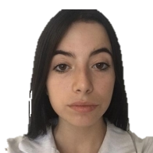



Our team
Elina Genova
Iliyana Michevska
Vanesa Kardzheva
Elena Keserdzhieva

Slide 3

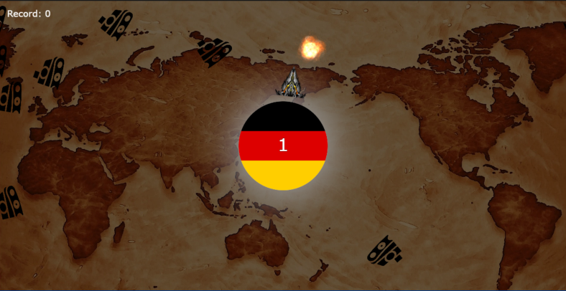
Design
War game
Color scheme

Slide 4
Stages of realization
Testing the code
Idea
Presentation
Distribution of tasks
Finished product

Slide 5







Used technologies

Slide 6
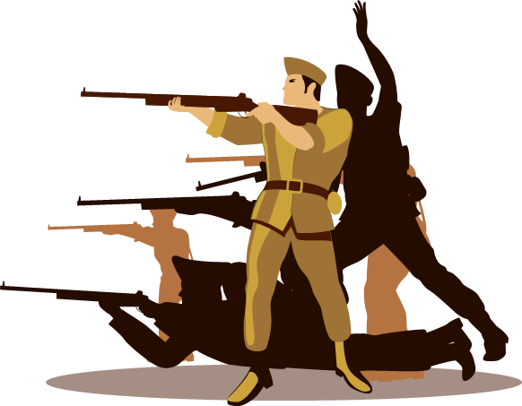
Repository

Slide 7
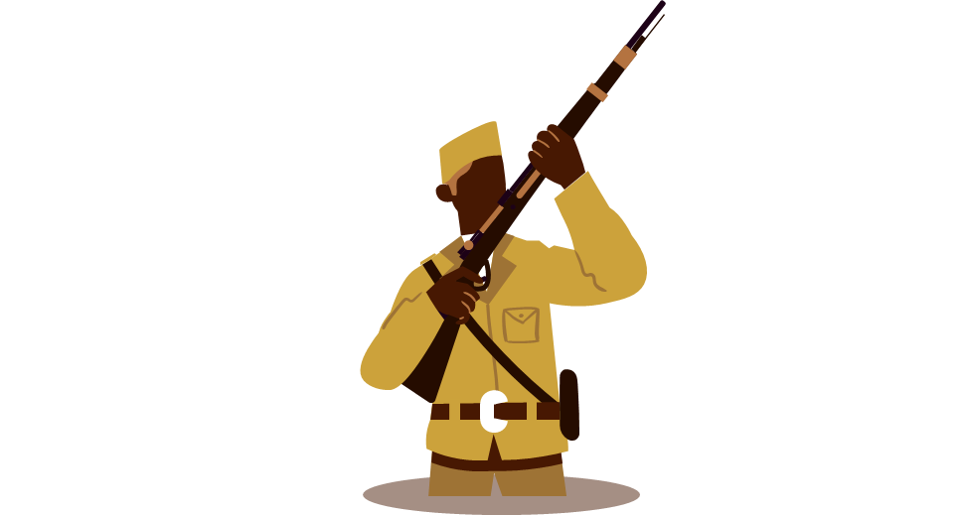
Demonstration

Slide 8
Thank you for your time!

